Slide 1
Lets check your understanding of Information Security

Slide 2
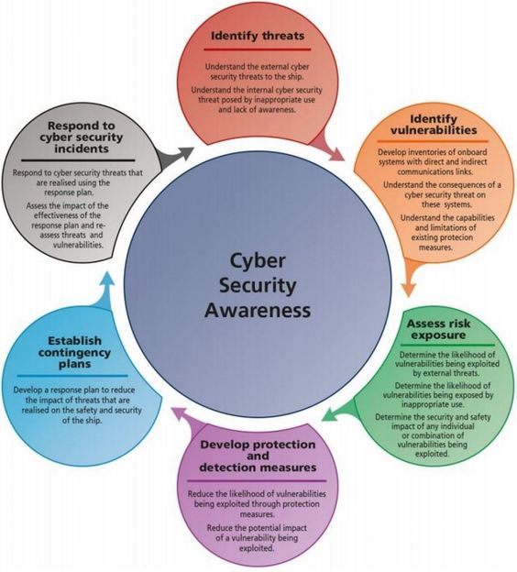
What Is Information Security?
The protection of the assets of a computer system
  Hardware
  Software
  Data
Or Networking Devices
Notes:
The NIST Computer Security Handbook [NIST95] defines the term computer security
as follows:
Computer Security: The protection afforded to an automated information
system in order to attain the applicable objectives of preserving the integrity,
availability, and confidentiality of information system resources (includes hardware,
software, firmware, information/data, and telecommunications).
This definition introduces three key objectives that are at the heart of computer
security:
• Confidentiality: This term covers two related concepts:
— Data confidentiality : 1 Assures that private or confidential information is
not made available or disclosed to unauthorized individuals.
— Privacy : Assures that individuals control or influence what information
related to them may be collected and stored and by whom and to whom
that information may be disclosed.
• Integrity: This term covers two related concepts:
— Data integrity : Assures that information and programs are changed only
in a specified and authorized manner.
— System integrity : Assures that a system performs its intended function in
an unimpaired manner, free from deliberate or inadvertent unauthorized
manipulation of the system.
• Availability: Assures that systems work promptly and service is not denied to
authorized users.

Slide 3
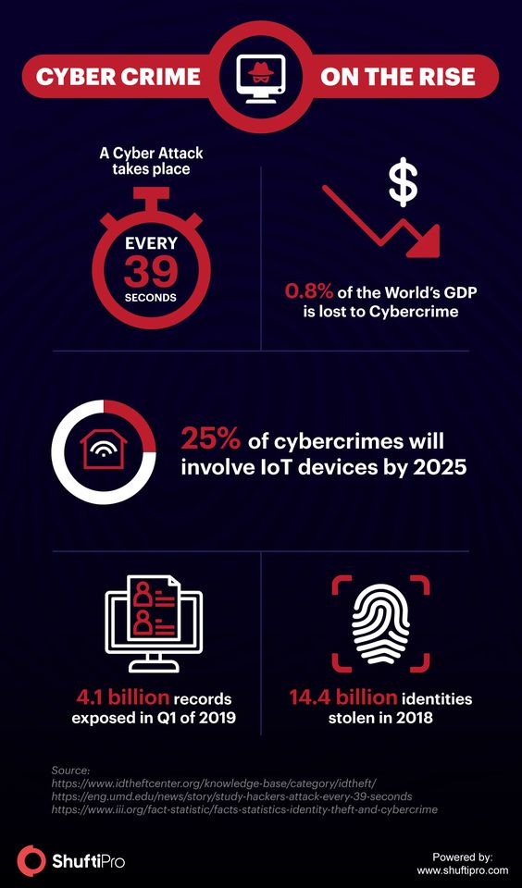
Values of Assets
Notes:
While hardware and software may be expensive, unique data cannot be replaced if it is lost.

Slide 4
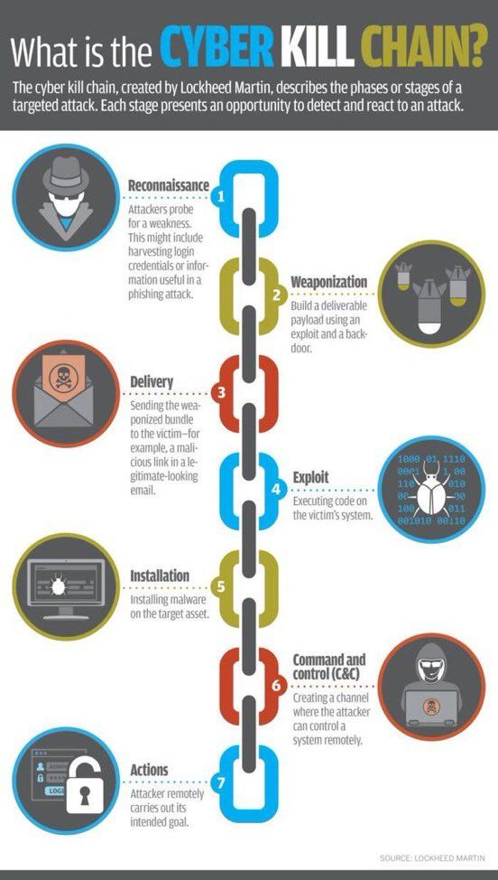
Threat & Vulnerability
Vulnerability
Threat
Attack
Countermeasure
or control
The water is the threat, the crack the vulnerability, and the finger the control (for now).
Notes:
The water is the threat, the crack the vulnerability, and the finger the control (for now).

Slide 5
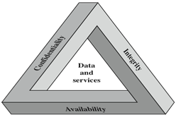
The CIA Triad / Security Traid
The National Institute of Standards and technology (NIST) Computer Security Handbook defines the term Computer Security as:
“The protection afforded to an automated information system in order to attain the applicable objectives of preserving the integrity, availability and confidentiality of information system resources” (includes hardware, software, firmware, information/data, and telecommunications).
Confidentiality
preserving authorized restrictions on information access and disclosure, including means for protecting personal privacy and proprietary information
Integrity
guarding against improper information modification or destruction, including ensuring information nonrepudiation and authenticity
Availability
ensuring timely and reliable access to and use of information
You can't say "I didn't do it" or "I didn't send that message" if there's evidence proving you did.
Notes:
FIPS PUB 199
provides a useful characterization of these three objectives in terms of requirements
and the definition of a loss of security in each category:
• Confidentiality: Preserving authorized restrictions on information access
and disclosure, including means for protecting personal privacy and proprietary
information. A loss of confidentiality is the unauthorized disclosure of
information.
• Integrity: Guarding against improper information modification or destruction,
including ensuring information non-repudiation and authenticity. A loss of
integrity is the unauthorized modification or destruction of information.
• Availability: Ensuring timely and reliable access to and use of information.
A loss of availability is the disruption of access to or use of information or an
information system.
Although the use of the CIA triad to define security objectives is well established,
some in the security field feel that additional concepts are needed to present
a complete picture. Two of the most commonly mentioned are as follows:
• Authenticity: The property of being genuine and being able to be verified and
trusted; confidence in the validity of a transmission, a message, or message
originator. This means verifying that users are who they say they are and that
each input arriving at the system came from a trusted source.
• Accountability: The security goal that generates the requirement for actions
of an entity to be traced uniquely to that entity. This supports nonrepudiation,
deterrence, fault isolation, intrusion detection and prevention, and after-action
recovery and legal action. Because truly secure systems aren’t yet an achievable
goal, we must be able to trace a security breach to a responsible party. Systems
must keep records of their activities to permit later forensic analysis to trace
security breaches or to aid in transaction disputes.
Note that FIPS PUB 199 includes authenticity under integrity.

Slide 6
Confidentiality
It ensures that computer-related assets are accessed only by authorized parties
Access means reading, viewing, printing, or simply knowing that a particular asset exists
It is sometimes also called secrecy or privacy

Slide 7
Integrity
It means that assets can be modified only by authorized parties only in authorized ways.
The integrity of an item is preserved if it is:
  Precise, accurate, unmodified, modified only in acceptable ways, modified by authorized people, modified by authorized processes, consistent, meaningful and usable.

Slide 8
Availability
It applies to both data and data processing
A data item, service or system is available if
  There is a timely response to our request
  Fair to all i.e. some requesters are not favored over others
  Fault tolerant
  There is controlled concurrency, deadlock management, and exclusive access as required

Slide 9
Access Control
Notes:
Visual explanation of basic access control terms

Slide 10
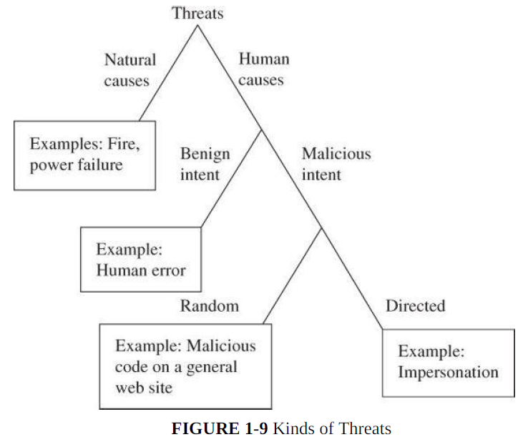
Types / Kinds of Threats
Notes:
This diagram shows threats categorized according to whether they are human-caused, malicious, or directed. These characteristics will affect security planning in important ways later.

Slide 11
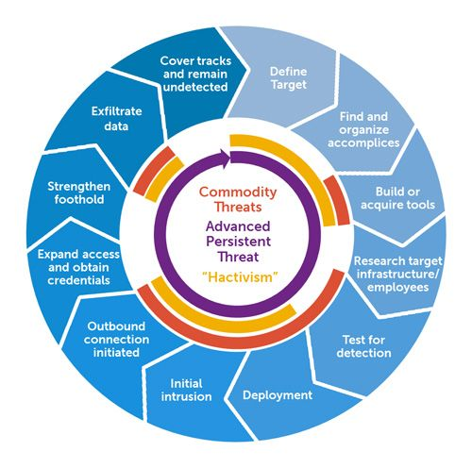
Advanced Persistent Threat (APT)
Organized
Directed
Well financed
Patient
Silent
APT is a special type of threat that has only been taken seriously by the broad security community over the past decade.
In general, security experts believe that no one who becomes a high-priority target can truly be safe from APT.

Slide 12
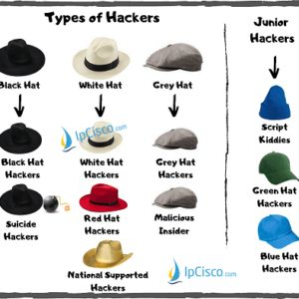
Types of Attackers
Each of these attacker types is associated with a different set of resources, capabilities & motivations.
Understanding the different types will help later in considering threats.

Slide 13
Types of Harm
The negative consequence of an actualized threat is harm; we protect ourselves against
threats in order to reduce or eliminate harm.
Examples of computer harm: a stolen computer, modified or lost file, revealed private letter, or denied
access to data. These events cause harm that we want to avoid.

Slide 14
Types of Harm: Security Attacks
Interruption: This is an attack on availability
Interception: This is an attack on confidentiality
Modification: This is an attack on integrity
Fabrication: This is an attack on authenticity

Slide 15
Vulnerability
It is is a weakness in the security of the computer system, for example, in procedures, design, or implementation, that might be exploited to cause loss or harm.
Think of a bank, with an armed guard at the front door, bulletproof glass protecting the tellers, and a heavy metal vault requiring multiple keys for entry. To rob a bank, you would have to think of how to exploit a weakness not covered by these defenses. For example, you might bribe a teller.
Computer systems have vulnerabilities, too.
Such as
weak authentication,
lack of access control, errors in programs,
finite or insufficient resources,
and inadequate physical protection.
Paired with a credible attack, each of these vulnerabilities can allow harm to confidentiality, integrity, or availability.

Slide 16
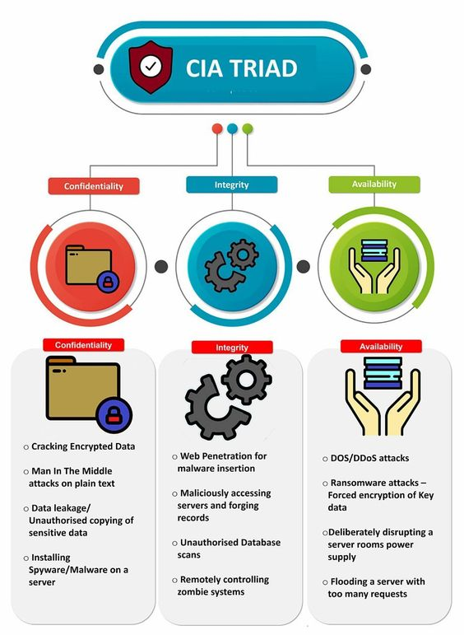
Controls / Countermeasures
The three dimensions by which a control can be categorized.
Thinking about controls in this way enables you to easily map the controls against the threats they help address.

Slide 17
Different Types of Controls
In this simple representation of a networked system, it is easy to see all the touch points where controls can be placed, as well as some different types of controls, including deterrence, deflection, response, prevention, and preemption.
Notes:
In this simple representation of a networked system, it is easy to see all the touch points where controls can be placed, as well as some different types of controls, including deterrence, deflection, response, prevention, and preemption.

Slide 18
Method, Opportunity and Motive
Method : the skills, knowledge, tools and other things with which to be able to pull off the attack
Opportunity : the time and access to accomplish the attack
Motive : a reason to want to perform this attack against this system
DENY ANY OF THESE THREE THINGS AND
ATTACKS WILL NOT OCCUR

Slide 19
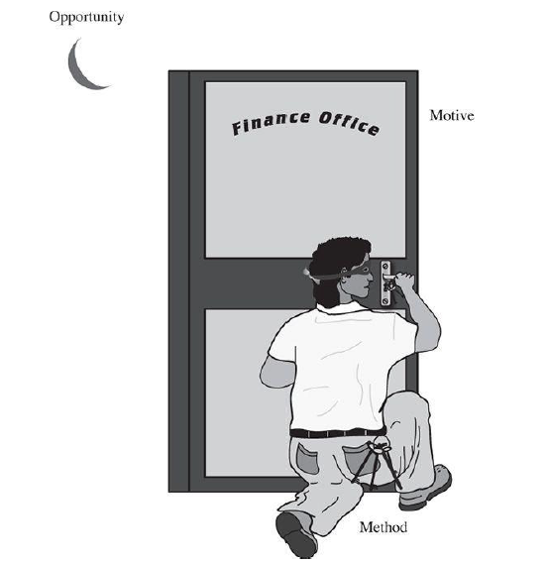
Method, Opportunity and Motive

Slide 20
Methods of Defense
Prevent it, by blocking the attack or closing the vulnerability
Deter it, by making attack harder if not impossible
Deflect it, by making another target more attractive
Mitigate it, by making its impact less severe
Detect it, either as it happens or some time after the fact
Recover from its effects

Slide 21
Methods of Defense
Controls
  Encryption
  Hardware Controls
    Hardware/smart card implementations of encryption
    Locks or cables limiting access
    Devices to verify users’ identity
    Firewalls
    Intrusion detection systems
  Software Controls
    Internal program controls,
    OS and Network system controls
    Independent control program (anti virus, passwords etc.)
    Development control
  Policies and Procedures
  Physical Controls

Slide 22
Classes and examples of type of control
• Physical controls stop or block an attack by using something tangible too, such as-
– walls and fences
– locks
– (human) guards
– sprinklers and other fire extinguishers
• Procedural or administrative controls use a command or agreement that
– requires or advises people how to act; for example,
– laws, regulations
– policies, procedures, guidelines
– copyrights, patents
– contracts, agreements
• Technical controls counter threats with technology (hardware or software), including
– passwords
– program or operating system access controls
– network protocols
– firewalls, intrusion detection systems
– encryption
– network traffic flow regulators

Slide 23
Effectiveness of Controls
Awareness of Problem
  Highlighting Need of security
Likelihood (probability) of Use
  They must be efficient, easy to use, and appropriate
Overlapping Controls
  Use several different controls, layered defense
Periodic reviews
  Judging the effectiveness of control is an ongoing task

